Slide 1
Machine Learning Systems (294-162)
Amir Gholami & Joseph E. Gonzalez

Slide 2
About Amir
PostDoc at RiseLab and BAIR
PhD: UT Austin class of 2017

Slide 3
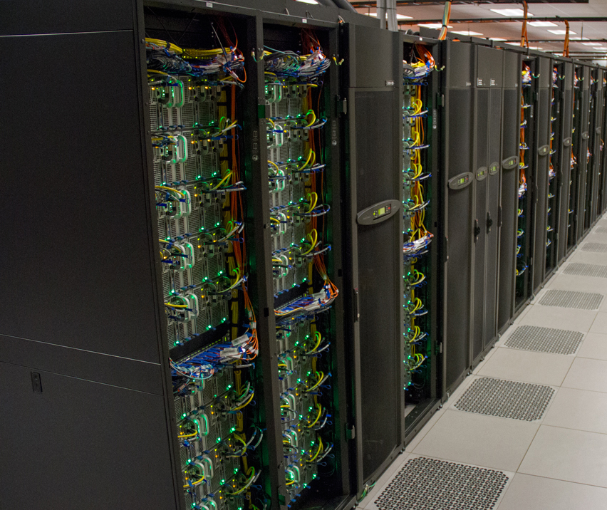

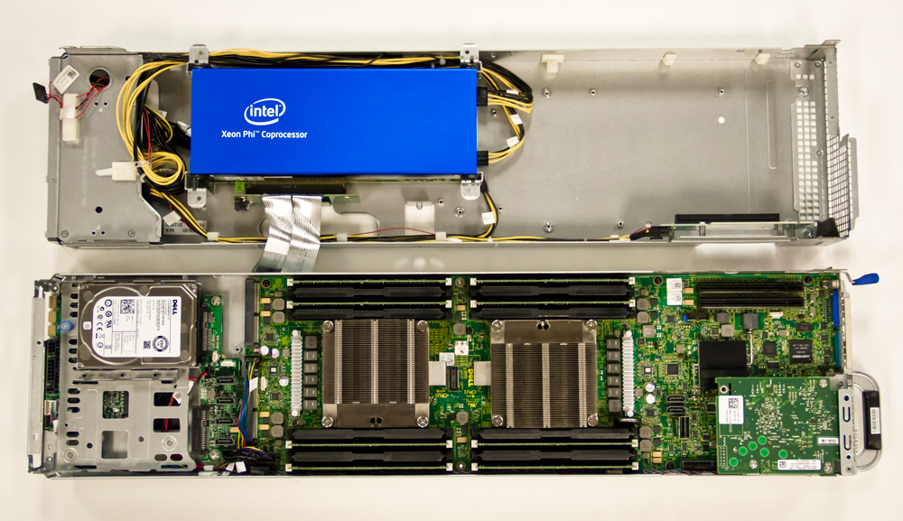
Back in 2011 – Golden Age of Large Scale Computing
Training
Data
ML Model
Very Expensive
Stampede 1 System at TACC: 6400 Intel Xeon nodes, 10 PFLOPS, $50M
(equivalent to 4 DGX-A100 systems today)

Slide 4
My story …
High Performance
Computing
Learning
Systems

Slide 5
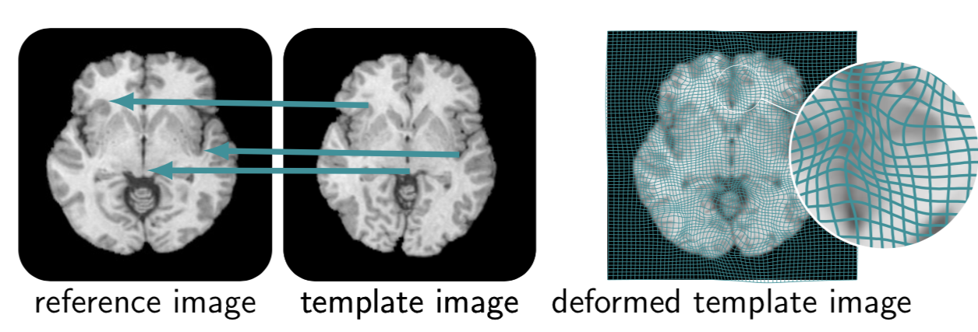
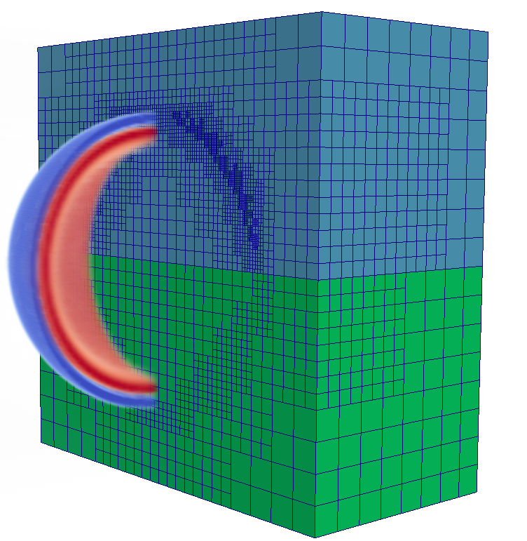
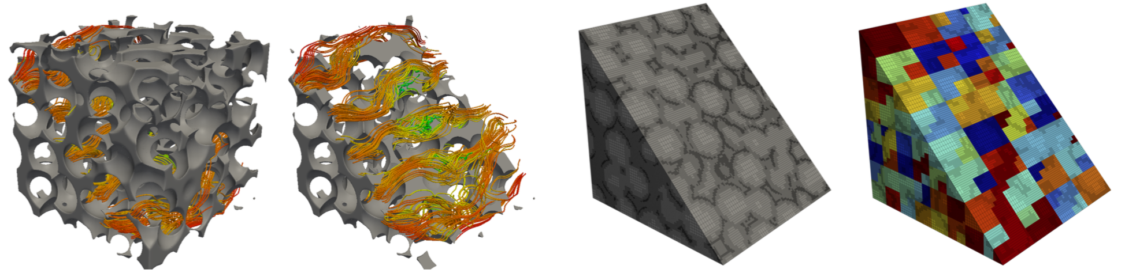
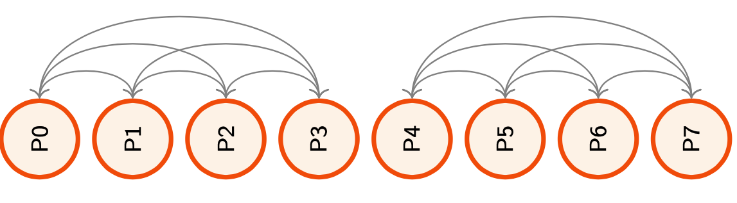
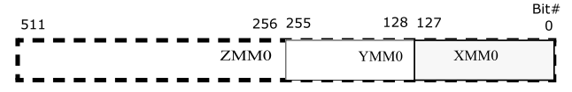
Use Supercomputers to Efficiently Solve Large Scale Problems
And this entailed a lot of low level compute and communication optimizations

Slide 6
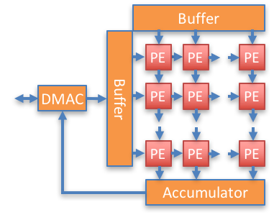
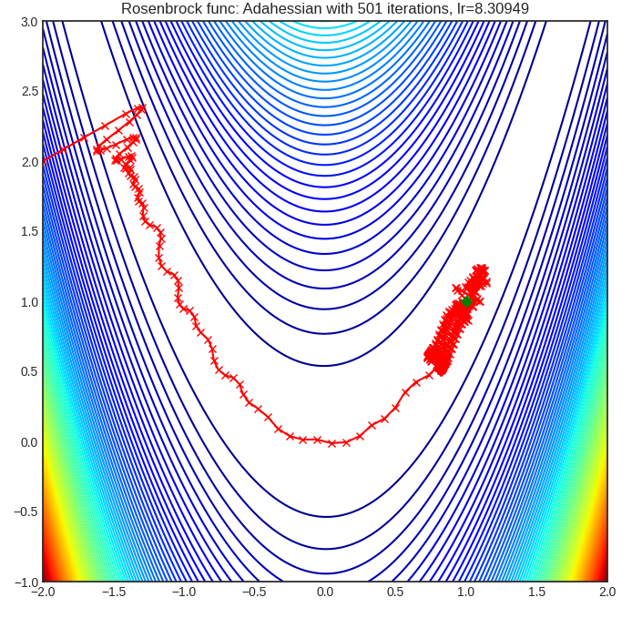
PostDoc Focus: Full Stack Deep Learning

Slide 7
About Joey

Slide 8
About Me
Currently on leave for new startup (http://spiralai.co)
Also expecting second child in a few weeks…
Co-director of the RISE Lab
Co-founder of Turi Inc.
Research
Machine Learning & Distributed Systems
Computer Vision, NLP, Secure Learning
Autonomous Driving, Robotics, Chemistry?
…

Slide 9
My story …
Machine Learning
Learning
Systems

Slide 10

Back in 2007

Slide 11
Back in 2007
I started studying the use of Gaussian Process (GP) models for wireless link quality estimation
Research was slowed by the speed of training
… and the fact that link quality is difficult to predict

Slide 12
Back in 2008
I started studying the use of Gaussian Process (GP) methods for wireless link quality estimation
I started studying parallel inference algorithms and systems
I designed and implemented parallel learning algorithms on top of low-level primitives …
Research was slowed by the speed of training
… and the fact that link quality is difficult to predict

Slide 13
ML
Paper
Application
Idea
Model +
Algorithm
Evaluate
Debug
Optimize
Distributed
Prototype
Serial
Prototype
Optimize
Parallel
Prototype
Evaluate
ML
Paper
Debug

Slide 14
Low-Level Primitives
Shared Memory Parallelism: pThreads & OpenMP
Distributed Communication: Actors & MPI
Yes,… I built an RPC framework and then an actor framework
Hardware APIs + Languages: GPU Programming (CUDA)
Low-level parallel primitives offer fine grained control over parallel execution.

Slide 15
Advantages of the Low-Level Approach
Extract maximum performance from hardware
Enable exploration of more complex algorithms
Fine grained locking
Atomic data-structures
Distributed coordination protocols
My implementation is better than your implementation.

Slide 16
Limitations of the Low-Level Approach
Repeatedly address the same system challenges
Algorithm conflates learning and system logic
Difficult to debug and extend
Typically does not address issues at scale: hardware failure, stragglers, …
Months of tuning and engineering for one problem.

Slide 17
Interesting Machine Learning
Research
ML
Paper
Application
Idea
Model +
Algorithm
Evaluate
Interesting Systems Research
Debug
Optimize
Abstraction
Distributed
Prototype
Serial
Prototype
Optimize
Parallel
Prototype
Evaluate
ML
Paper
Debug

Slide 18
Design Complexity
Parallelism
Model
Network
Locality
Large-Scale
Systems
Machine Learning
Stragglers
Scheduling
Training
Accuracy
Fault Tolerance

Slide 19
Design Complexity
Parallelism
Model
Network
Locality
Interaction
Large-Scale
Systems
Machine Learning
Stragglers
Scheduling
Training
Accuracy
Fault Tolerance
Notes:
----- Meeting Notes (6/16/14 16:21) -----
Move items into the black box

Slide 20
Design Complexity
Parallelism
Model
Network
Locality
Interaction
Large-Scale
Systems
Machine Learning
Stragglers
Scheduling
Training
Accuracy
Fault Tolerance
Learning systems combine the complexities of machine learning with system design
Notes:
----- Meeting Notes (6/16/14 16:21) -----
Move items into the black box

Slide 21
Managing Complexity Through Abstraction
Learning Algorithm
Common Patterns
Identify common patterns
Define a narrow
interface
Abstraction (API)
System
Exploit limited abstraction
to address system
design challenges
Parallelism
Data Locality
Network
Scheduling
Fault-tolerance
Stragglers
Notes:
----- Meeting Notes (6/16/14 16:21) -----
fault tolerance check hyphen

Slide 22
PhD in Machine Learning from CMU 2013
Scalable
Systems
Abstractions
Machine Learning
X₃
X₂
Machine 1
Machine 2
Y₃
X₁
Y₂
Y₁
Graphical Model Inference
Vertex
Program
GraphLab/GraphX
System

Slide 23
Looking Back on AI Systems
How did the field evolve during the time I was doing my PhD

Slide 24
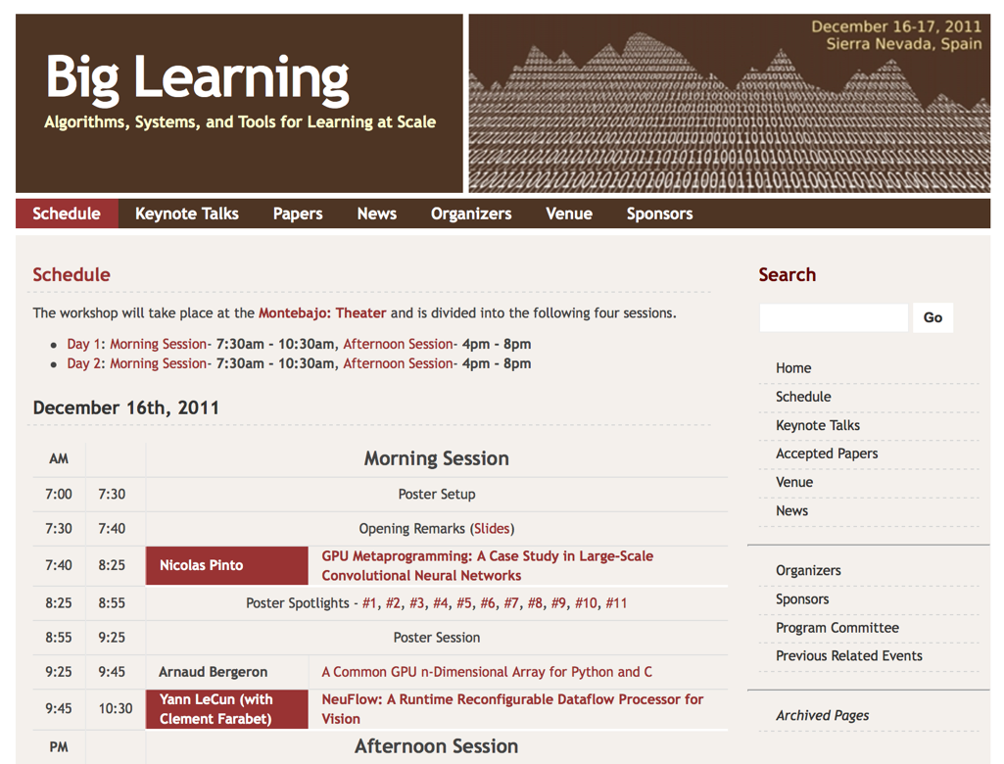
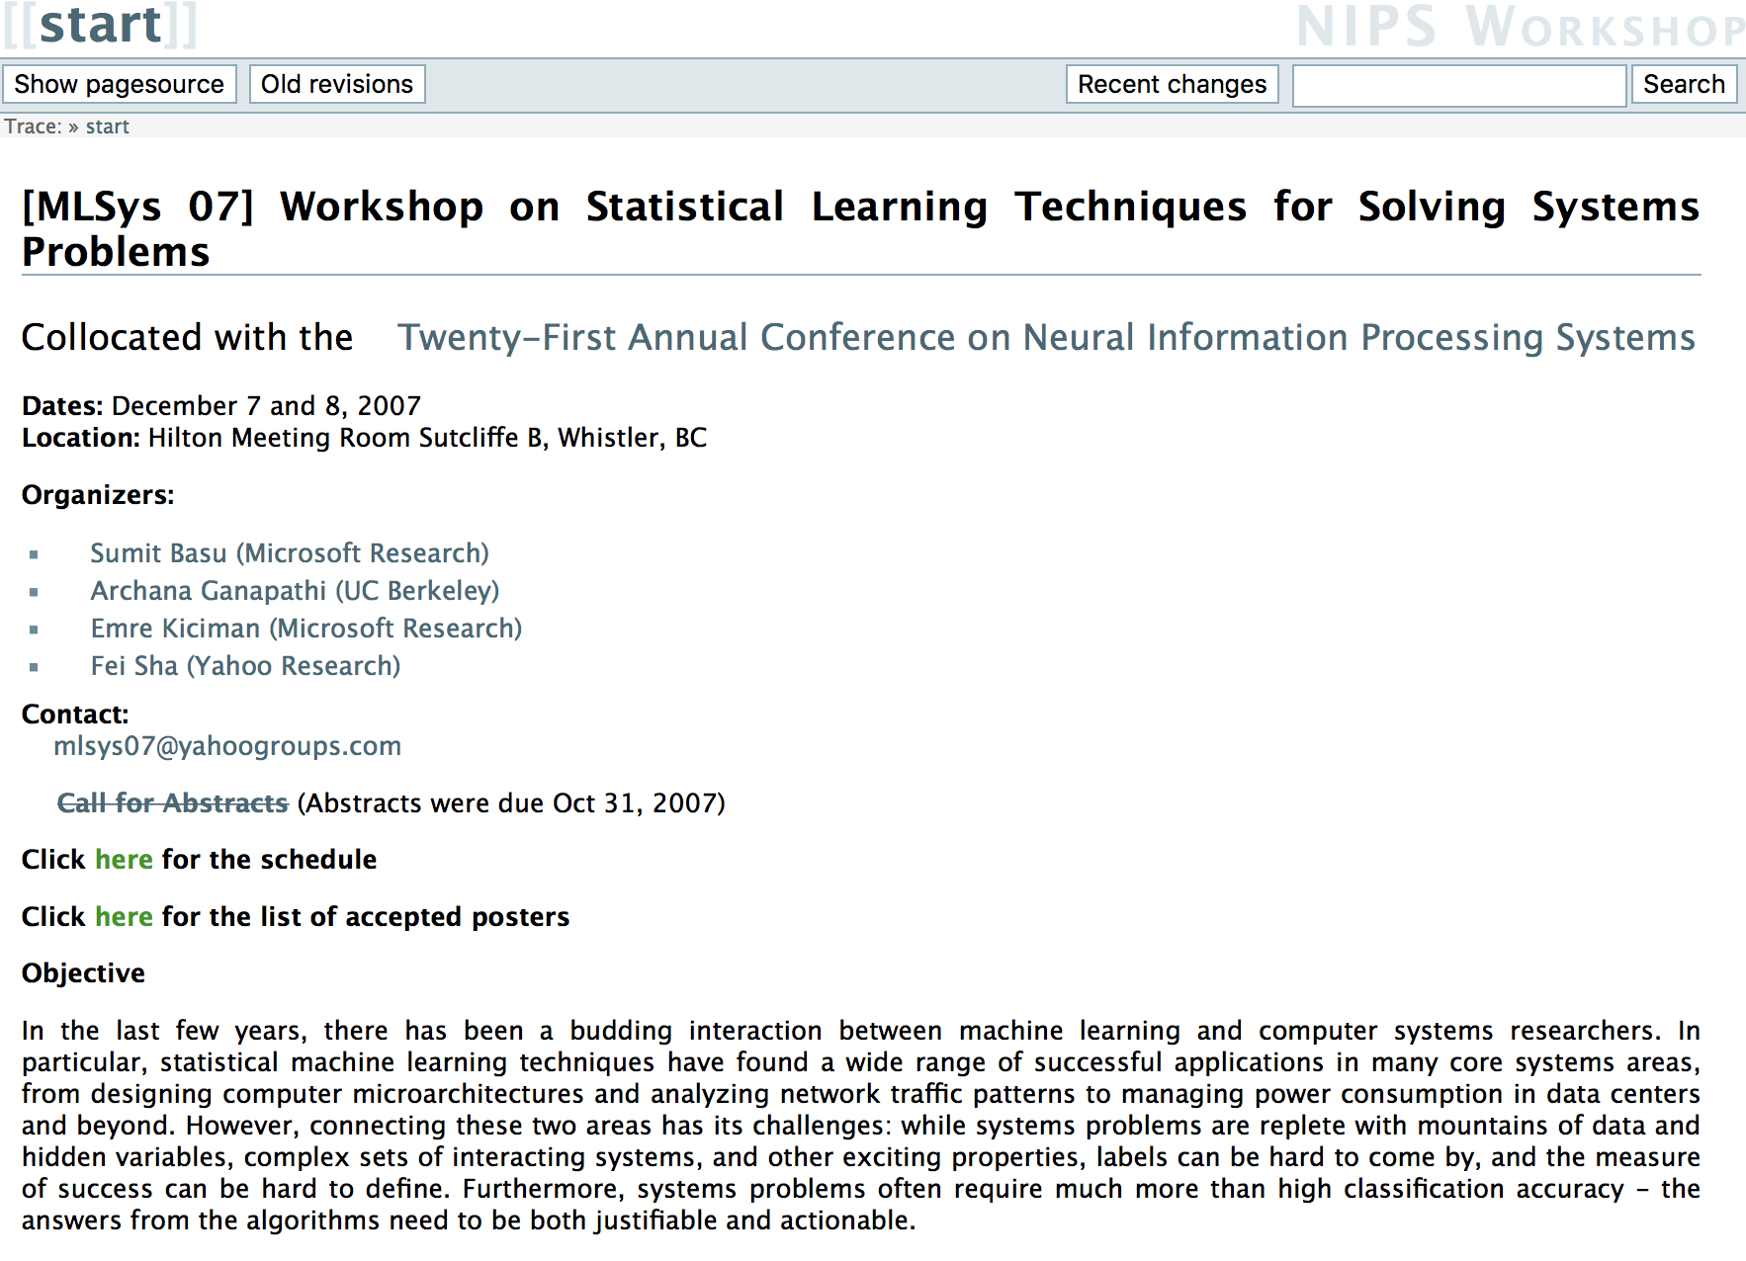
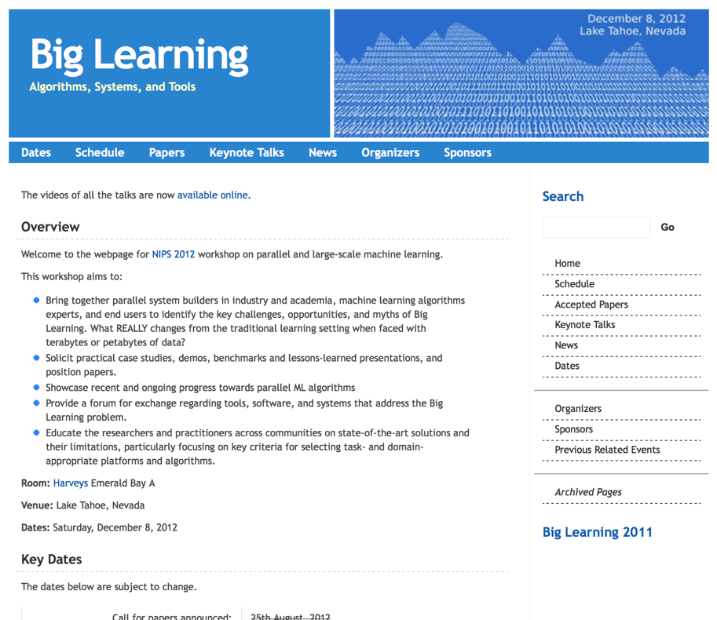
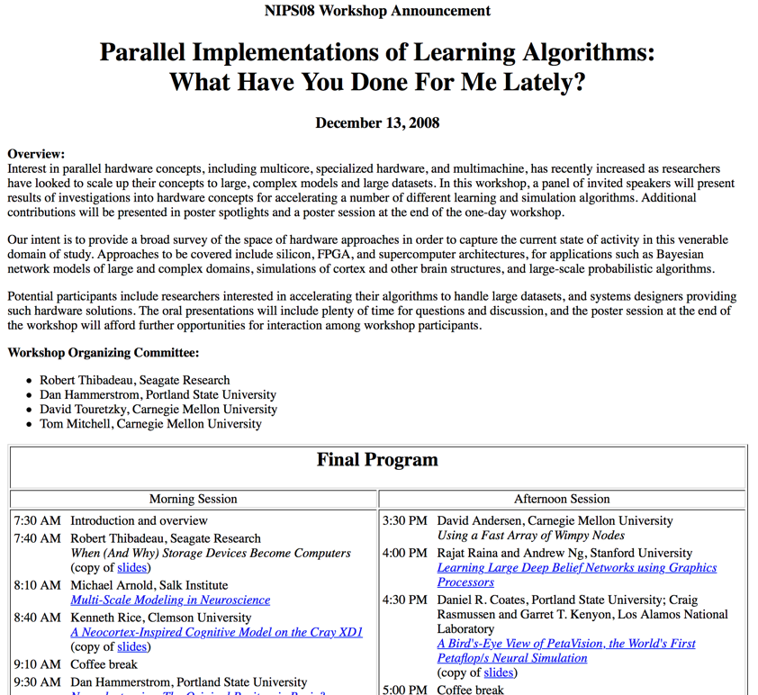
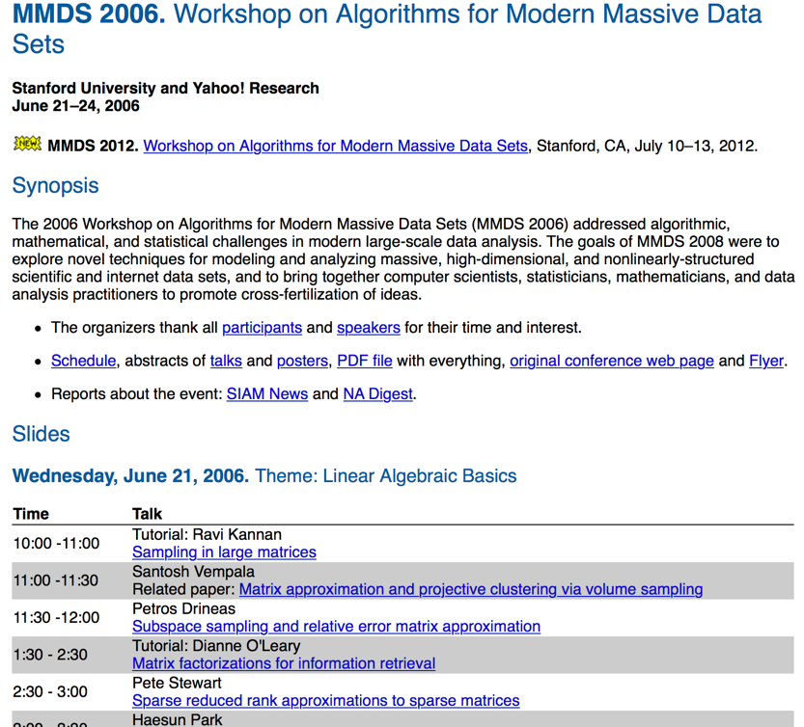
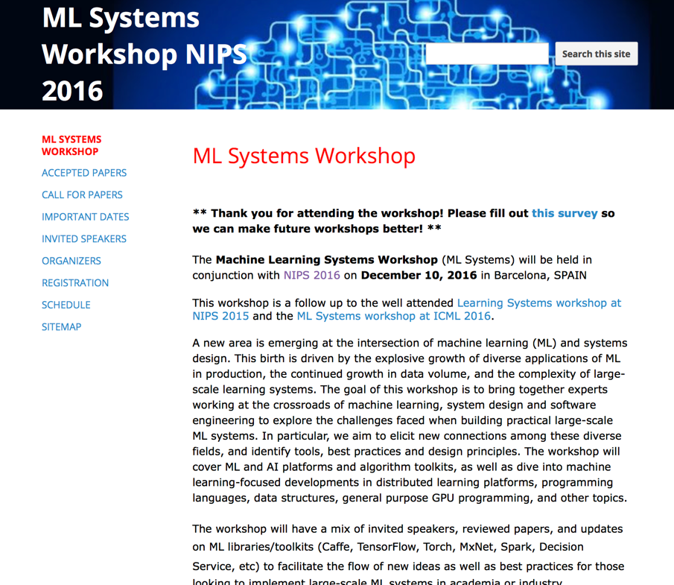
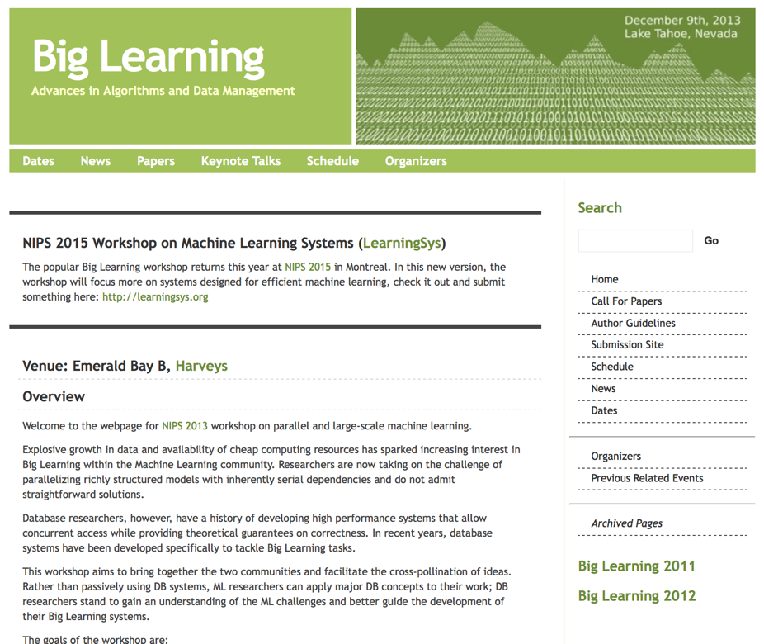
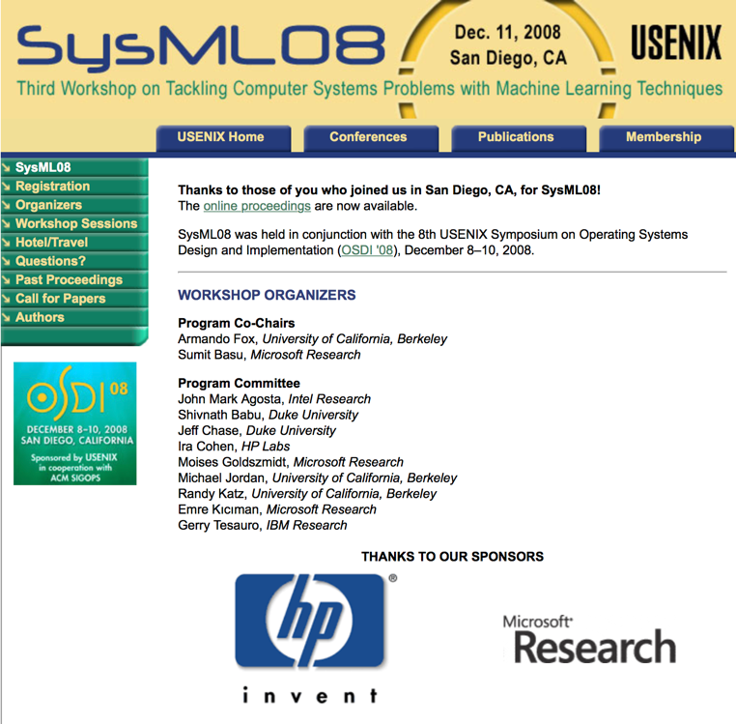
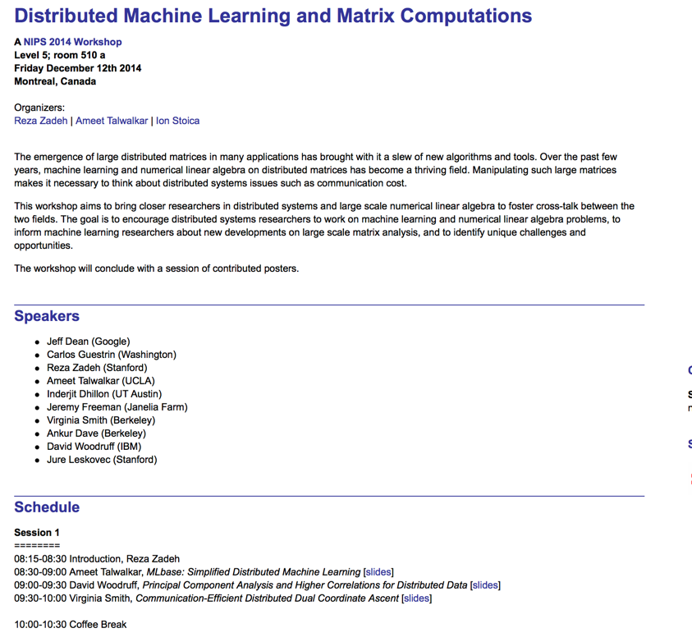
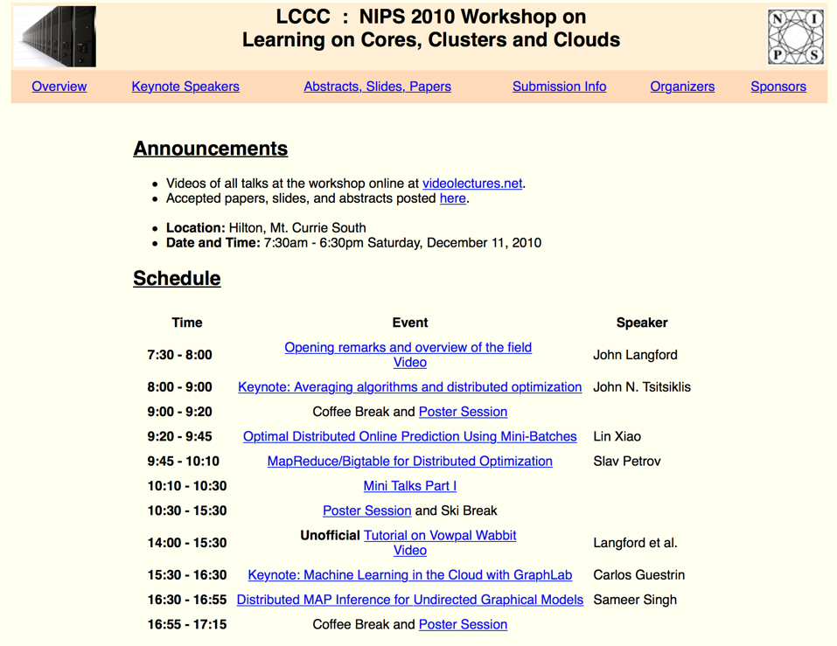
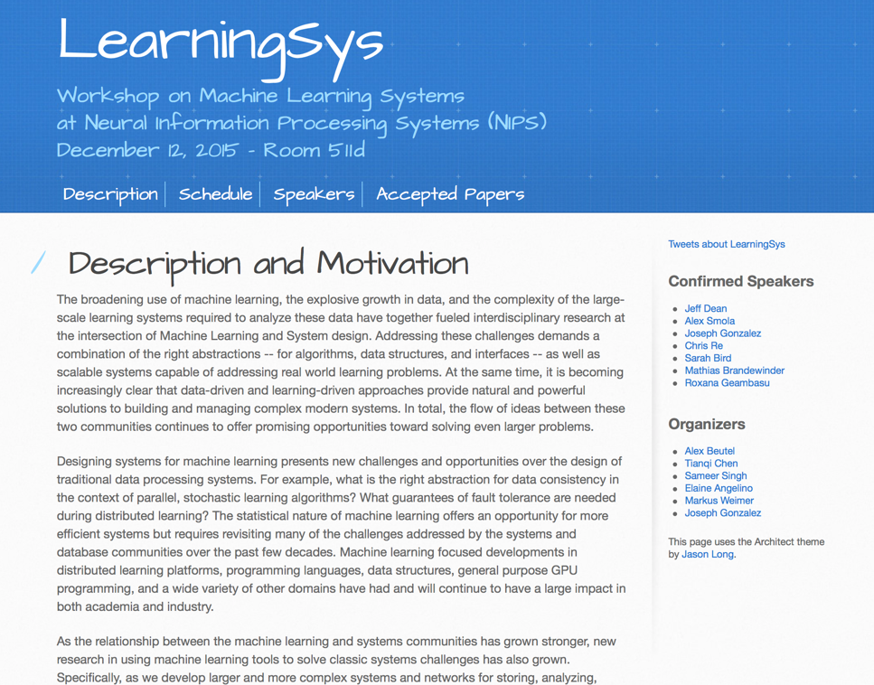
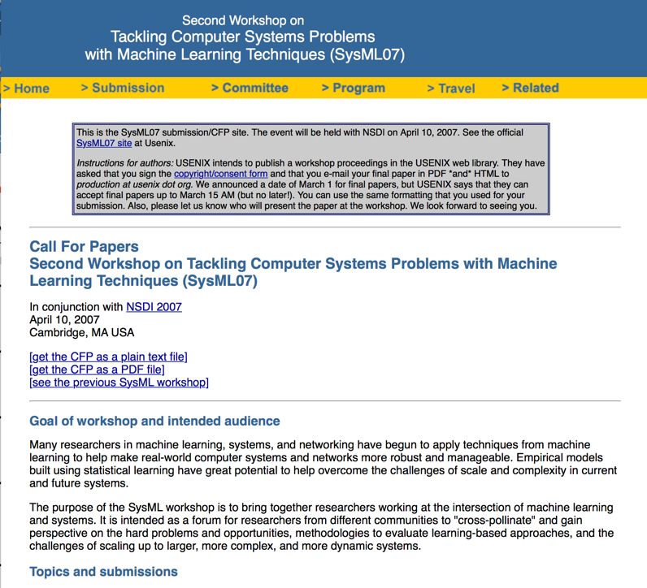
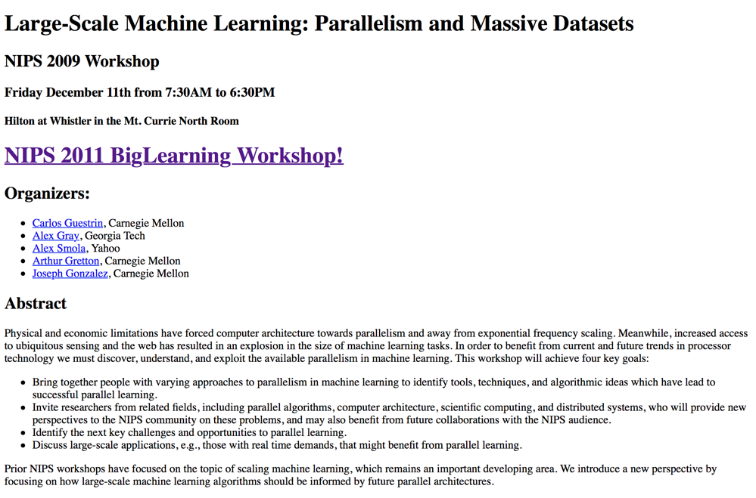


Slide 25
Machine learning community has had an evolving focus on AI Systems
Fast
Algorithms
Distributed
Algorithms
Deep Learning
Frameworks
Transformers Everywhere
2009
2022
ML for
Systems
Machine Learning Frameworks
RL for
Systems
Massive General
Models
Integration of
Communities

Slide 26
Systems and the Third Wave of AI

Slide 27
Waves of AI Research
1950 to 1974: Birth of AI
1950 Alan Turing publishes the Imitation Game
1951 Marvin Minsky builds first neural network machine (SNARC)
DARPA starts to pour money into AI Research (limited oversight)
Incredible optimism
“Within ten years a digital computer will be the world’s chess champion” -- Herbert A. Simon and Allen Newell (1958)
“In from three to eight years we will have a machine with the general intelligence of an average human being”
– Marvin Minksy (1970)
Notes:
Wikipedia notes on SNARC (Stochastic Neural Analog Reinforcement Calculator) is a neural net machine designed by Marvin Lee Minsky.^{[1]} Prompted by a letter from Minsky, George Armitage Miller gathered the funding for the project from the Air Force Office of Scientific Research in the summer of 1951 with the work to be carried out by Minsky, who was then a graduate student in mathematics at Princeton University. At the time, a physics graduate student at Princeton, Dean S. Edmonds,^{[2]} volunteered that he was good with electronics and therefore Minsky brought him onto the project.
The machine itself is a randomly connected network of approximately 40 Hebb synapses. These synapses each have a memory that holds the probability that signal comes in one input and another signal will come out of the output. There is a probability knob that goes from 0 to 1 that shows this probability of the signals propagating. If the probability signal gets through, a capacitor remembers this function and engages a "clutch". At this point, the operator will press a button to give reward to the machine. At this point, a large motor starts and there is a chain that goes to all 40 synapse machines, checking if the clutch is engaged or not. As the capacitor can only "remember" for a certain amount of time, the chain only catches the most recent updates of the probabilities.
This machine is considered one of the first pioneering attempts at the field of artificial intelligence. Minsky went on to be a founding member of MIT's Project MAC, which split to become the MIT Laboratory for Computer Science and the MIT Artificial Intelligence Lab, and is now the MIT Computer Science and Artificial Intelligence Laboratory. In 1985 Minsky became a founding member of the MIT Media Laboratory.

Slide 28
Waves of AI Research
1950 to 1974: Birth of AI
1974 to 1980: First AI Winter
Technology was unable to meet the high expectations
Insufficient computer power
Over emphasis on combinatorial search
Insufficient knowledge (data)
1969 Book “Perceptrons” by Minsky and Papert
Showed that certain basic functions (e.g., parity) cannot be computed using local connections
Strong argument against connectionist approaches to AI (neural networks)
Government funding dries
Not meeting objectives
DARPA focuses more on immediate impact

Slide 29
Waves of AI Research
1950 to 1974: Birth of AI
1974 to 1980: First AI Winter
1980 to 1987: Second Wave of AI
Expert systems start to solve real-world problems
CMU developed XCON (AI for Systems) for DEC → saves $40M annually
Combines “knowledge” (expert rules “data”) with logic
Japanese government invests $850M in AI Research
Other governments respond by also investing heavily
Emergence of the AI hardware and software industry

Slide 30
Waves of AI Research
1950 to 1974: Birth of AI
1974 to 1980: First AI Winter
1980 to 1987: Second Wave of AI
1987 to 1993: Second AI Winter
Expert systems too brittle to maintain
Collapse of the specialized AI hardware market
Commodity hardware was improving too rapidly
Ultimately over 300 AI companies would vanish from the market
Massive government funding cuts
Notes:
Over 300 AI companies had shutdown, gone bankrupt, or been acquired by the end of 1993, effectively ending the first commercial wave of AI

Slide 31
Waves of AI Research
1950 to 1974: Birth of AI
1974 to 1980: First AI Winter
1980 to 1987: Second Wave of AI
1987 to 1993: Second AI Winter
1993 to 2011: AI Goes Stealth Mode (aka Machine Learning)
Hardware becomes fast enough, and AI techniques start to work
Deep Blue beats Garry Kasparov (1997)
OCR, Speech Recognition, Google Search, …
Confluence of ideas and techniques: optimization, statistics, probability theory, and information theory

Slide 32
Waves of AI Research
1950 to 1974: Birth of AI
1974 to 1980: First AI Winter
1980 to 1987: Second Wave of AI
1987 to 1993: Second AI Winter
1993 to 2011: AI Goes Stealth Mode (aka Machine Learning)
Hardware becomes fast enough, and AI techniques start to work
Deep Blue beats Garry Kasparov (1997)
OCR, Speech Recognition, Google Search, …
Confluence of ideas and techniques: optimization, statistics, probability theory, and information theory

Slide 33
Waves of AI Research
1950 to 1974: Birth of AI
1974 to 1980: First AI Winter
1980 to 1987: Second Wave of AI
1987 to 1993: Second AI Winter
1993 to 2011: AI Goes Stealth Mode (aka Machine Learning)
2011 to 2019: Third Wave (AI Goes Deep)
Large quantities of data in conjunction with advances in hardware and software enable the design and training of complex models
New applications emerge
Autonomous driving, home automation, AR/VR, …
AI Market frenzy →
Gartner Forecasts Worldwide Artificial Intelligence Software Market to Reach $62 Billion in 2022
Worldwide revenues for the artificial intelligence (AI) market, including software, hardware, and services, are forecast to grow 16.4% year over year in 2021 to $327.5 billion, according to the latest release of the International Data Corporation (IDC) Worldwide Semiannual Artificial Intelligence Tracker.
Notes:
Over 300 AI companies had shutdown, gone bankrupt, or been acquired by the end of 1993, effectively ending the first commercial wave of AI

Slide 34
Will there be a 3rd winter?

Slide 35
Joey’s Forecast: A Chilly Spring and a Warm Summer
Hype still exceeds reality…
However, we are finally delivering significant value from AI-Systems.
Those systems are also continuing to improve with investment.
They are enabling new products and creating market opportunities.

Slide 36
Research in AI and Systems for AI is Exploding

Slide 37
Why?
“A New Golden Age in Computer Architecture: Empowering the Machine-Learning Revolution”,
https://ieeexplore.ieee.org/document/8259424

Slide 38
New Forces Driving AI Revolution
Data
Compute
Abstractions
Benchmarks
Advances in
Algorithms and
Models
1998
Convolutional Networks
1951
Notes:
Herbert Robbins; Sutton Monro

Slide 39
What defines good AI-Systems Research Today?

Slide 40
What defines good AI-Systems Research Today?

Slide 41
Big Ideas in ML Research
Generalization (Underfitting/Overfitting)
What is being “learned”?
Inductive Biases and Representations
What assumptions about domain enable efficient learning?
Efficiency (Data and Computation)
How much data and time are needed to learn?
Details: Objectives/Models/Algorithms

Slide 42
What makes a great (accepted) paper?
State of the art results
Accuracy, Sample Complexity, Qualitative Results …
Novel settings, problem formulations, and benchmarks
Innovation in techniques: architecture, training methodology, …
Theoretical results that provide a deeper understanding
----
Narrative and framing in prior work and current trends?
Parsimony? Are elaborate solutions rejected? If they work better?
Verification of prior results?

Slide 43
What defines good AI-Systems Research Today?

Slide 44
Big Ideas in Systems Research
Managing Complexity
Abstraction, modularity, layering, and hierarchy
Tradeoffs
What are the fundamental constraints?
How can you reach new points in the trade-off space?
Problem Formulation
What are the requirements and assumptions?

Slide 45
What makes a great (accepted) paper?
State of the art results
throughput, latency, resource reqs., scale, …
Problem formulations and benchmarks
Innovation in techniques
Algorithms, data-structures, policies, software abstractions.
What you remove or restrictions often more important
Narrative and framing in prior work and current trends?
Verification of prior results?
Open source? Real-world use?

Slide 46
What defines good AI-Systems Research Today?

Slide 47
What is AI-Systems Research?
Good AI and Systems research
Provides insights to both communities
Builds on big ideas in prior AI and Systems Research
Leverages understanding of both domains
Studies statistical and computational tradeoffs
Identify essential abstractions to bridge AI and Systems
Reframes systems problems as learning problems
More than just great open-source software!
But software impact often matters…
Notes:
1) an ML paper that builds a new distributed learning algorithm without discussing interaction with systems (This is just modern ML work) 2) a systems paper that builds a system for scheduling ML jobs that would be the same without the ML-ness of those jobs. (This is just systems work which has applications to ML.) 3) a software framework that is just software without any insight or design ideas. (Just because you wrote software does not make it SysML research.)

Slide 48
Kinds of AI-Systems Research

Slide 49
AI + Systems
Advances in AI are being used to address fundamental challenges in systems.

Slide 50
AI + Systems
Advances in AI are being used to address fundamental challenges in systems.
Reinforcement Learning for
Pandas code generation
SQL join planning
Network packet classification
Autoscaling
Bandit Algorithms for radio link adaptation
Wireless link quality estimation
Multi-task learning for straggler mitigation
VM Selection using Trees ..

Slide 51
AI + Systems
Advances in systems are enabling substantial progress in AI

Slide 52
AI + Systems
Developing Systems for:
Autonomous Vehicles
Reinforcement Learning
Secure Machine Learning
Prediction Serving
Experiment Management
Advancing AI
Dynamic Neural Nets
Prediction on Compressed Data
Distributed Training
Distributed Auto-ML
Advances in systems are enabling substantial progress in AI

Slide 53
AI + Systems
Berkeley is the place to be for
Research
Advances in systems are enabling substantial progress in AI

Slide 54
About You?

Slide 55
Background Requirements
You have taken previous courses in either
Systems (for example CS162) → comfortable building systems and familiar with big ideas in system design
Machine Learning (for example CS189) → comfortable training neural networks and familiar with big ideas in ML
You are actively involved in research in either systems or machine learning (or both)
If this does not describe you, email me (jegonzal@Berkeley.edu) and we can talk about your situation.

Slide 56
Enrolling in the Class (and the Waitlist)
We were able to extend to 45 students
Currently prioritizing PhD and MS students (>45 students)
Willing to admit strong undergrads if there is room
Fill out this form: https://forms.gle/cn1DS5owivBbniA78
In previous offerings around 10% of students dropped
This is a seminar class – attendance is required.
You may attend virtually (via zoom)!
If you would like to enroll please participate in first weeks.

Slide 57
Reasons not to take this class … ☹
If you plan to drop this class, please drop it soon so others can enroll!
If you want to learn how to train models and use TensorFlow, PyTorch, and SkLearn
Take: CS C100, CS182, CS189
If you want learn how to use big data systems
Take: CS162, CS186
You are not interested in learning how to evaluate, conduct, and communicate research
Why not?
You are unable to (virtually) attend lecture

Slide 58
Goals for the Class
What do you expect from this class?

Slide 59
My Goals for the Class
Identify and solve impactful problems at the intersection of AI and Systems
Learn about the big ideas and key results in AI systems
Learn how to read, evaluate, and peer review papers
Learn how to write great papers that also get published!
Have Fun!

Slide 60
How will we achieve these goals?
Lectures and Reading: study developments in AI Systems
Identify the key open problems and research opportunities
Guest speakers every week to discuss research and process.
Projects: collaboration between Systems and AI students
Explore open problems and produce top tier publications
In Class Reviews: weekly reviews of papers
Learn both how to evaluate papers and understand how papers are reviewed

Slide 61
Simple Grading Policy
20% Class Participation
Attend lecture and participate in class discussions
Lead 3 in class discussions (sign-up)
https://docs.google.com/spreadsheets/d/1mh9JG1CVgUKMy98xSm8ssI8FEWbITL_8rcBjH2tk0SE/edit?usp=sharing
20% Weekly Reviews
Submit weekly paper reviews (google form)!
60% Class Projects
Do great research!

Slide 62
Problems
What makes a good problem?

Slide 63
What makes a good problem?
Impact: People care about the solution
… and progress advances our understanding (research)
Metrics: You know when you have succeeded
Can you measure progress on the solution?
Divisible: The problem can be divided into smaller problems
You can identify the first sub-problem.
Your Edge: Why is it a good problem for you?
Leverage your strengths and imagine a new path.

Slide 64
Can you Solve a Solved Problem?
Ideally you want to solve a new and important problem
A new solution to a solved problem can be impactful if:
It supports a broader set of applications (users)
It reveals a fundamental trade-off or
Provides a deeper understanding of the problem space
10x Better?
Often publishable…
Should satisfy one of the three above conditions.

Slide 65
Class Organization

Slide 66
Weekly Topic Organization
Each week we will cover a new topic
There will be 3 required papers to read each week
Format of Each Lecture (3 hours!!!!)*
~45 Minute review of topic area for the next WEEK
We want to give context to help with reading
~60 Minute: Extended PC discussion around the reading
20 minutes per paper 3 presenters (Summary, Strengths, Weaknesses)
Fixed Slide Format (Link)
~15 Minute Break
60 Minutes: Presentation from Invited Speaker with Discussion
*Format may change based on speaker constraints.

Slide 67
PC Meeting Format
https://docs.google.com/presentation/d/1iI7arlEPDTQp2VpHtOTS_ghg_oG03TT0ulwyqG6ZHUM/edit?usp=sharing

Slide 68
In Class PC Meeting Format (V.1)
For each of the three papers: (20 Minutes per paper)
Neutral: recap of the paper (neutral opinion) [5 Minutes]
Advocate: Strengths of the paper [5 Minutes]
Critic: Weaknesses of the paper [5 Minutes]
Class will discuss rebuttal and improvements [5 Minutes]

Slide 69
The Neutral Presenter will Summarize
What is the problem being solved and what was the solution? (Summary!)
What is the context of this work? What is the most relevant related work?
What metrics did they use to evaluate their solution?
What was the Baselines of comparison?
What was the key insight or enabling idea?
What are the claimed technical contributions?

Slide 70
Advocate and Critic Will Discuss
Novelty and Impact
Are the problem and solution novel and how will the solution affect future research?
Technical Qualities
Are the problem framing and assumptions reasonable
Discuss merits of the technical contributions
Does the evaluation support claims and reveal limitations of the proposed approach?
Presentation
Discuss the writing clarity and presentation of results
Positioning of related work

Slide 71
Break + Action Items
Go to website: https://ucbrise.github.io/cs294-ai-sys-sp22/
Join Slack (we are discontinuing piazza)
https://join.slack.com/t/cs294-ai-sys-sp22/shared_invite/zt-120vm629j-pos6xUIfrt_xgaCMM_aaUw
Signup for 3 discussion slots as different roles here:
https://docs.google.com/spreadsheets/d/1mh9JG1CVgUKMy98xSm8ssI8FEWbITL_8rcBjH2tk0SE/edit?usp=sharing

Slide 72
Context for Big Data Systems

Slide 73
Why discuss big data systems in this class?
Data is central to machine learning
But what systems do you use for your data?
Data systems are often overlooked in ML-Systems research
Potential area for exciting new research
Industry: Data systems control everything!
3 Papers:
How to incorporate ML into a classic database systems
How to scale data processing for ML workloads
Current trends in large-scale data systems driven by ML

Slide 74
Relational Database Systems
Logically organize data in relations (tables)
Structured Query Language (SQL) to define, manipulate and compute on data.
A common language used by many data systems
Describes logical organization of data as well as computation

Slide 75
SQL is a Declarative Language
Declarative: “Say what you want, not how to get it.”
Declarative Example: I want a table with columns “x” and “y” constructed from tables “A” and ”B” where the values in “y” are greater than 100.00.
Imperative Example: For each record in table “A” find the corresponding record in table “B” then drop the records where “y” is less than or equal to 100 then return the ”x” and “y” values.
Advantages of declarative programming
Enable the system to find the best way to achieve the result.
More compact and easier to learn for non-programmers (Maybe?)
Challenges of declarative programming
System performance depends heavily on automatic optimization
Limited language (not Turing complete) → need extensions

Slide 76
Physical Data Independence
Physical data layout/ordering is determined by system
goal of maximizing performance
Data Clustering
Organize group of records to improve access efficiency
Example: grouped/ordered by key
Implications on Learning?
Record ordering may depend on data values
Arbitrary ordering ≠ Random ordering

Slide 77
User Defined Aggregates
Provide a low-level API for defining functions that aggregate state across records in a table
Much like fold in functional Programming
CREATE AGGREGATE agg_name (…){
initialize(state) → state
transition(state, row) → state
terminate(state) → result
merge(state, state) → state
}
# Initialize the state for aggregation.
# Advance the state for one row. Invoked repeatedly.
# Compute final result.
# (Optional) Merge intermediate states from parallel executions.
Merge

Slide 78
Closed Relational Model and Learning
All operations on tables produce tables…
Training a model on a table produces?
A row containing a model
A table containing model weights
An (infinite) table of predictions
MauveDB: Supporting Model-based User Views in Database Systems
Predictions as views
Opportunity to index predictions
Relational operations to manipulate predictions

Slide 79
Out-of-core Computation
Database systems are typically designed to operate on databases larger than main memory (big data?)
Algorithms must manage memory buffers and disk
Page level memory buffers
Sequential reads/writes to disk
Understand relative costs of memory vs disk

Slide 80
Reasoning about Memory Hierarchy
Latency Numbers Every Programmer Should Know --Jeff Dean
L1 Cache
L2 Cache
Main Memory
Read 1MB from RAM (Seq.)
Read 1MB SSD (Seq.)
Read 1MB Disk (Seq.)
0.5 ns (few clock cycles)
7 ns
100 ns
250K ns
1M ns (1ms)
20M ns (20ms)
Notes:
https://gist.github.com/jhclark/2845836
1 ns = 10-9 seconds
1 ms = 10-3 seconds

Slide 81
Reasoning about Memory Hierarchy
Latency Numbers Every Programmer Should Know
Human Readable
L1 Cache 1 second
L2 Cache 14 seconds
Main Memory 3.3 minutes
Read 1MB from RAM (Seq.) 5.8 days
Read 1MB SSD (Seq.) 23 days
Read 1MB Disk (Seq.) 1.3 years
Database Systems
Page Buffers
Sequential
Read/Write
Notes:
https://gist.github.com/jhclark/2845836
1 ns = 10-9 seconds
1 ms = 10-3 seconds

Slide 82
Transactional vs Analytics Data Systems
Transactional (OLTP) Systems: address source of truth data used by live services
Bank records, user profiles,
Designed for low-latency, availability, transactional consistency, durability
Analytics (OLAP) Systems : store and manage data to support large-scale analysis
Business intelligence, sales, fraud, targeting
Designed for high-throughput, scalability, rich computation

Slide 83
Operational Data Stores
Data Warehouse
Sales
(Asia)
Capture the now
Many different databases across an organization
Mission critical… be careful!
Serving live ongoing business operations
Managing inventory
Different formats (e.g., currency)
Different schemas (acquisitions ...)
Live systems often don’t maintain history
Collects and organizes historical data from multiple sources
Sales
(US)
Inventory
Advertising
We would like a consolidated, clean, historical snapshot of the data.
Notes:
Why do we want history: What was the balance of my account last week? We don’t have that; only the current state. What if you want analysis over time?

Slide 84
Sales
(Asia)
Data Warehouse
ETL
Collects and organizes historical data from multiple sources
Sales
(US)
ETL
ETL
Inventory
Data is periodically ETLed into the data warehouse:
Extracted from remote sources
Transformed to standard schemas
Loaded into the (typically) relational (SQL) data system
ETL
Advertising

Slide 85
Extract → Transform → Load (ETL)
Extract & Load: provides a snapshot of operational data
Historical snapshot
Data in a single system
Isolates analytics queries (e.g., Deep Learning) from business critical services (e.g., processing user purchase)
Easy!
Transform: clean and prepare data for analytics in a unified representation
Difficult → often requires specialized code and tools
Different schemas, encodings, granularities
Notes:
What could go wrong here? Don’t want to drop data silently. System goes down when you make the request. Input data format changes. (This happens!)

Slide 86
Recent Trend: ETL --> ELT
Previously transformation was needed to reduce burden on data warehouse
Improvements in data warehouse performance have eliminated the need to transform before loading
Driven by trends in datalakes …
New ecosystem of software for:
Extract and Load: e.g., Fivetran and Stitch
Transform: DBT

Slide 87
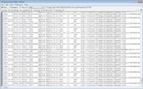

Sales
(Asia)
Data Warehouse
Sales
(US)
ETL
ETL
Collects and organizes historical data from multiple sources
Inventory
ETL
Advertising
ETL
ETL ?
How do we deal with semi-structured and unstructured data?
Do we really want to force a schema on load?
Text/Log Data
Photos & Videos
It is Terrible!
Notes:
in traditional ETL, everything had to conform to predetermined schema before load happened... doesn't necessarily work with this kind of data -- especially audio / video / images

Slide 88
Sales
(Asia)
Data Warehouse
How do we clean and organize this data?
Sales
(US)
ETL
ETL
Collects and organizes historical data from multiple sources
Inventory
Depends on use …
ETL
Advertising
ETL
ETL ?
How do we deal with semi-structured and unstructured data?
Do we really want to force a schema on load?
How do we load and process this data in a relational system?
Text/Log Data
Depends on use…
Can be difficult...
Requires thought...
Photos & Videos
It is Terrible!

Slide 89

Data Warehouse
Sales
(Asia)
Data Lake
*
How do we clean and organize this data?
Sales
(US)
ETL
Store a copy of all the data
in one place
in its original “natural” form
Enable data consumers to choose how to transform and use data.
Schema on Read
ETL
Inventory
Depends on use …
ETL
Advertising
ETL
ETL ?
How do we load and process this data in a relation system?
Text/Log Data
Depends on use …
Can be difficult ...
Requires thought ...
Photos & Videos
What could go wrong?
It is Terrible!
*Still being defined…[Buzzword Disclaimer]

Slide 90
The Dark Side of Data Lakes
Cultural shift: Curate → Save Everything!
Noise begins to dominate signal
Limited data governance and planning
Example: hdfs://important/joseph_big_file3.csv_with_json
What does it contain?
When and who created it?
No cleaning and verification → lots of dirty data
New tools are more complex and old tools no longer work

Slide 91
A Brighter Future for Data Lakes
Data Scientists and ML Engineers
Distributed data processing and cleaning
Machine learning, computer vision, and statistical sampling
Technologies are improving
SQL over large files
Self describing columnar file formats (Parquet, ORC)
Organizations are evolving
Tracking data usage and file permissions
New job title: data engineers
Starting to see convergence of warehouse and data lakes
Lakehouse™?

Slide 92
How do we store and compute on large unstructured datasets
Requirements:
Handle very large files spanning multiple computers
Use cheap commodity devices that fail frequently
Distributed data processing quickly and easily
Solutions:
Distributed file systems → spread data over multiple machines
Assume machine failure is common → redundancy
Distributed computing → load and process files on multiple machines concurrently
Assume machine failure is common → redundancy
Functional programming computational pattern → parallelism

Slide 93
Fault Tolerant Distributed File Systems
B
Big File
A
[Ghemawat et al., SOSP’03]
Big File
Split large files over multiple machines
Easily support massive files spanning machines
Read parts of file in parallel
Fast reads of large files
Often built using cheap commodity storage devices
C
D
Machine1
Machine 2
B
C
A
B
D
C
Machine 3
Machine 4
Cheap commodity storage devices will fail!
A
C
A
B
D
D
Notes:
Big ideas also appear in xFS (1995)

Slide 94
The Map Reduce Abstraction
Key
Value
Key
Value
Map
Reduce
Record
Key
Value
Key
Value
Value
Example: Word-Count
Map(docRecord) {
for (word in docRecord) {
emit (word, 1)
}
}
Reduce(word, counts) {
emit (word, SUM(counts))
}
Key
Value
Map: Deterministic
Reduce: Commutative and Associative
[Dean & Ghemawat, OSDI’04]

Slide 95
Key properties of Map And Reduce
Deterministic Map: allows for re-execution on failure
If some computation is lost we can always re-compute
Issues with samples?
Commutative Reduce: allows for re-order of operations
Reduce(A,B) = Reduce(B,A)
Example (addition): A + B = B + A
Is floating point math commutative?
Associative Reduce: allows for regrouping of operations
Reduce(Reduce(A,B), C) = Reduce(A, Reduce(B,C))
Example (max): max(max(A,B), C) = max(A, max(B,C))
Notes:
Remember: we need to be able to deal with failures.

Slide 96
Executing Map Reduce
Key
Value
Map
Record
Key
Value

Slide 97
Executing Map Reduce
Machine1
B
C
D
Machine 2
A
B
C
Map
Map
Map
Map
Machine 3
Distributing the Map Function
A
C
D
Machine 4
A
B
D

Slide 98
Executing Map Reduce
Machine1
B
C
Map
D
Machine 2
A
B
Map
C
Machine 3
Distributing the Map Function
A
C
Map
D
Machine 4
A
B
Map
D

Slide 99
Executing Map Reduce
Machine1
apple
1
B
C
Map
cat
1
D
the
2
Machine 2
big
1
A
B
Map
cat
3
C
the
1
The map function applied to a local part of the big file.
Run in Parallel.
Machine 3
A
C
Map
cat
1
D
dog
1
Machine 4
A
B
Map
big
1
D
dog
1
Output is cached for fast recovery on node failure

Slide 100
Executing Map Reduce
Machine1
apple
1
B
C
Map
cat
1
D
the
2
Machine 2
big
1
A
B
Map
cat
3
C
the
1
Machine 3
Key
Value
A
C
Reduce
Map
cat
1
Key
Value
D
dog
1
Value
Machine 4
A
B
Map
big
1
Reduce function can be run on many machines …
D
dog
1

Slide 101
Executing Map Reduce
Machine1
Reduce
B
C
Map
apple
1
apple
1
D
the
2
Reduce
Machine 2
the
3
1
A
B
Map
C
cat
1
Reduce
Run in Parallel
3
cat
5
Machine 3
1
A
C
Map
D
big
1
Reduce
1
big
2
Machine 4
A
B
Map
Reduce
dog
1
1
dog
2
D

Slide 102
Executing Map Reduce
Machine1
Reduce
B
C
Map
apple
1
D
the
2
Reduce
Machine 2
Output File
1
A
B
Map
apple
1
C
cat
1
the
3
Reduce
3
cat
5
Machine 3
1
big
2
A
C
Map
dog
2
D
big
1
Reduce
1
Machine 4
A
B
Map
Reduce
dog
1
D
1

Slide 103
Executing Map Reduce
Machine1
Reduce
Output File
B
C
Map
apple
1
apple
1
D
the
3
the
2
Reduce
cat
5
Machine 2
1
big
2
A
B
Map
dog
2
C
cat
1
Reduce
3
Machine 3
If part of the file or any intermediate computation is lost we can simply recompute it without recomputing everything.
1
A
C
Map
D
big
1
Reduce
1
Machine 4
A
B
Map
Reduce
dog
1
D
1

Slide 104

Learning from Statistics (Aggregation)*
Learning Algorithm
Query:
System
Data
D. Caragea et al., A Framework for Learning from Distributed Data Using Sufficient Statistics and Its Application to Learning Decision Trees. Int. J. Hybrid Intell. Syst. 2004
Chu et al., Map-Reduce for Machine Learning on Multicore. NIPS’06.
*next set of slides are old!
Notes:
Chu and several others (including me) have incorrectly attributed this pattern to the statistical query model of M. Kearns, STOC’93.

Slide 105
Can we compute
using the statistical query pattern in map-reduce?
Query:
Algorithm
Response:

Slide 106
Can we compute
using the statistical query pattern in map-reduce?
Query 1
Query 2
Query:
Algorithm
Break computation into two queries
Response:

Slide 107
Cost Analysis
Comutation
Cost
When n >> p we want to distribute this computation

Slide 108
Logistic Regression using Gradient Descent?
What about

Slide 109
Logistic Regression in Map-Reduce
Gradient descent:
Learning Algorithm
Query:
System
Data
Update Model:

Slide 110
Logistic Regression in Map-Reduce
Map-Reduce is not optimized for iteration and multi-stage
computation
Gradient descent:
Learning Algorithm
Query:
System
Data
Update Model:

Slide 111
Iteration in Map-Reduce
Initial
Model
Learned
Model
Map
Reduce
w⁽⁰⁾
w⁽¹⁾
Training
Data
w⁽²⁾
w⁽³⁾

Slide 112
Cost of Iteration in Map-Reduce
Initial
Model
Learned
Model
Map
Reduce
w⁽⁰⁾
w⁽¹⁾
Read 1
Training
Data
Repeatedly load same data
Read 2
w⁽²⁾
Read 3
w⁽³⁾

Slide 113
Cost of Iteration in Map-Reduce
Initial
Model
Learned
Model
Map
Reduce
w⁽⁰⁾
w⁽¹⁾
Training
Data
Redundantly save output between stages
w⁽²⁾
w⁽³⁾

Slide 114

Iteration and Multi-stage computation
In-Memory
Dataflow
System
M. Zaharia, M. Chowdhury, M. J. Franklin, S. Shenker, and I. Stoica. Spark: cluster computing with working sets. HotCloud’10
M. Zaharia, M. Chowdhury, T. Das, A. Dave, J. Ma, M. McCauley, M.J. Franklin, S. Shenker, I. Stoica. Resilient Distributed Datasets: A Fault-Tolerant Abstraction for In-Memory Cluster Computing, NSDI 2012

Slide 115
Dataflow View
Map
Reduce
Training Data
(HDFS)
Map
Reduce
Map
Reduce

Slide 116
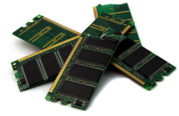
Memory Opt. Dataflow
Map
Reduce
Cached
Load
Training Data
(HDFS)
Map
Reduce
Map
Reduce
10-100× faster than network and disk

Slide 117
Memory Opt. Dataflow View
Map
Reduce
Efficiently move data
between stages
Training Data
(HDFS)
Map
Reduce
Map
Reduce

Slide 118
Databricks Company
Launched out of Berkeley and Spark Project
Focused on data lake technology
Competing with data warehouses:
AWS Redshift: probably most successful AWS service but structured and priced more like a traditional data warehouse
Google BigQuery: Very successful (and flexible) data warehouse system which separates storage from compute
Snowflake: Similar to BigQuery but cross cloud and slightly different pricing models

Slide 119
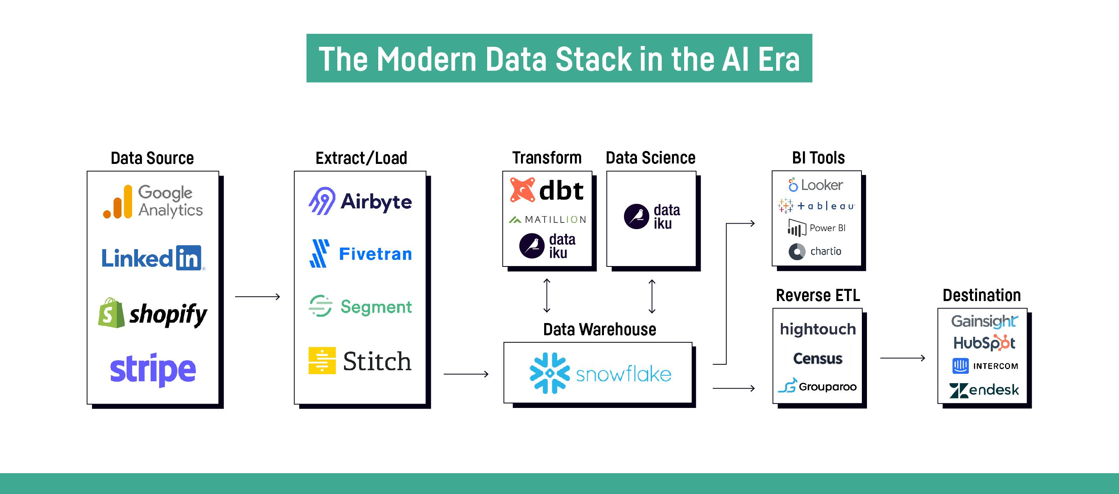
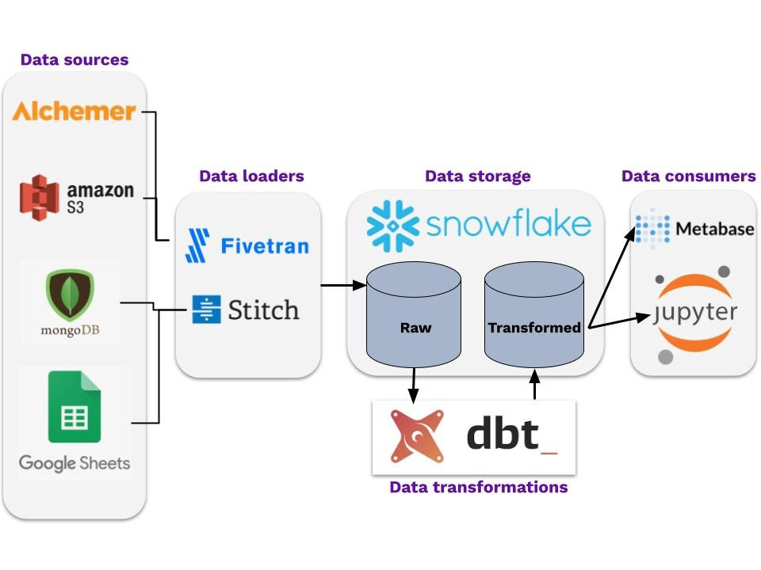
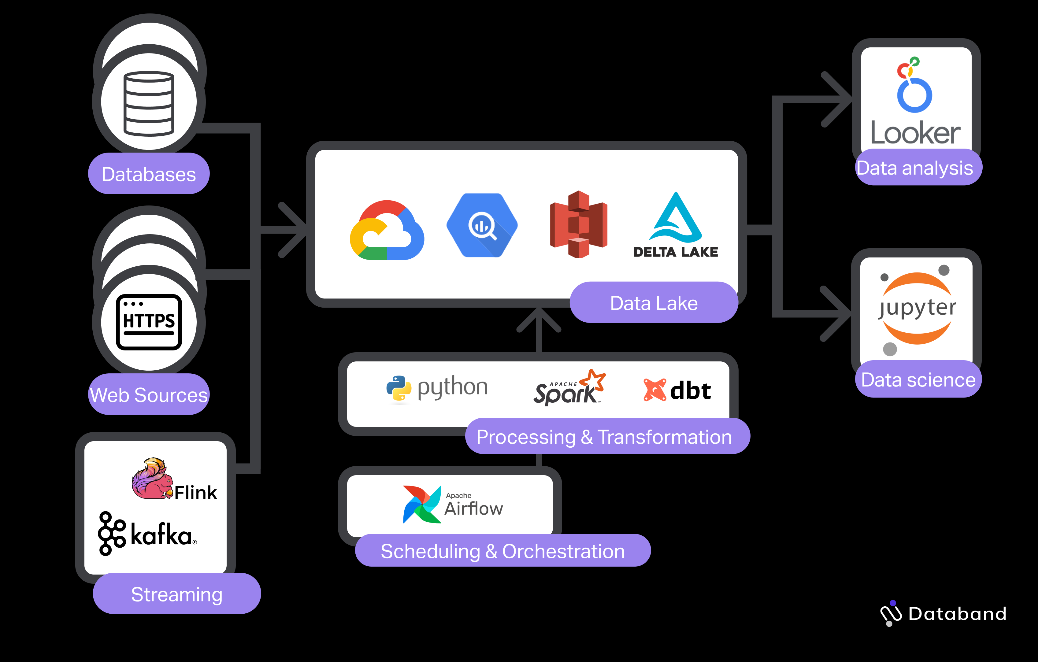
Modern Data Stack
Great Blog Post: https://blog.getdbt.com/future-of-the-modern-data-stack/

Slide 120
Thoughts for Reading this Week?
Older papers → What has changed in ML and Systems since these were written.
Would you use any of these systems:
To support your research?
To build new systems?
What are some biases in the author’s perspectives?

